Slide 1
Machine Learning - Project 2
Joseph Bieselin – JAB975@nyu.edu

Slide 2
Goal
Use a new machine learning algorithm on any dataset
Dataset is from Kaggle’s Titanic competition
Various information about passengers that boarded the Titanic
Prepare dataset for use in R
Use LASSO Regression for analysis
Algorithm will be used to see if a passenger would have survived the shipwreck

Slide 3
Required Packages
glmnet
ROCR

Slide 4
Data Preparation – read in file
data <- read.csv("http://christianherta.de/lehre/dataScience/machineLearning/data/titanic-train.csv",header=T)

Slide 5
Data Preparation – remove invalid contents
data <- data[,c(2,3,5,6,10)]
data <- data[complete.cases(data),]

Slide 6
Data Preparation – training/testing sets
set.seed(101)
testing <- sample(714, 200, replace=FALSE)
traindata <- data[-testing, ]
testdata <- data[testing, ]
dim(traindata) # 514 5
dim(testdata) # 200 5

Slide 7
Data Analysis – look at some of the data
prop.table(table(traindata$Sex))
# female male
# 0.3618677 0.6381323
prop.table(table(traindata$Survived))
# 0 1
# 0.5894942 0.4105058
prop.table(table(traindata$Sex, traindata$Survived))
# 0 1
# female 0.08949416 0.27237354
# male 0.50000000 0.13813230

Slide 8
Data Analysis – setup training and testing data
traindata.factored <- traindata
traindata.factored$Sex <- as.numeric(traindata.factored$Sex)
testdata.factored <- testdata
testdata.factored$Sex <- as.numeric(testdata.factored$Sex)

Slide 9
Data Analysis – LASSO models
# get the LASSO model
lasso.model <- glmnet(as.matrix(traindata.factored[,2:5]), as.matrix(traindata.factored[,1]), family="binomial", alpha=1)
# get cross-validated LASSO model to estimate the optimal lambda
cv.lasso.model <- cv.glmnet(as.matrix(traindata.factored[,2:5]), as.matrix(traindata.factored[,1]), family="binomial", alpha=1)
# estimated optimal lambda
cv.lasso.model$lambda.min # 0.00245966

Slide 10
Data Analysis – viewing model plots
plot(lasso.model)

Slide 11
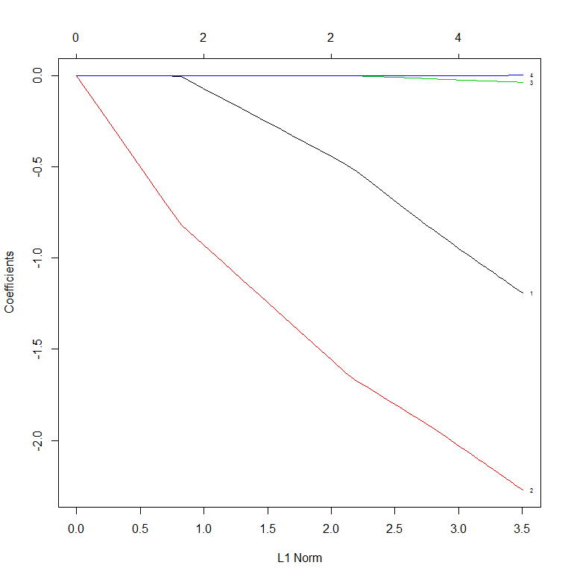
Data Analysis – lasso.model

Slide 12
Data Analysis – viewing model plots
plot(cv.lasso.model)

Slide 13
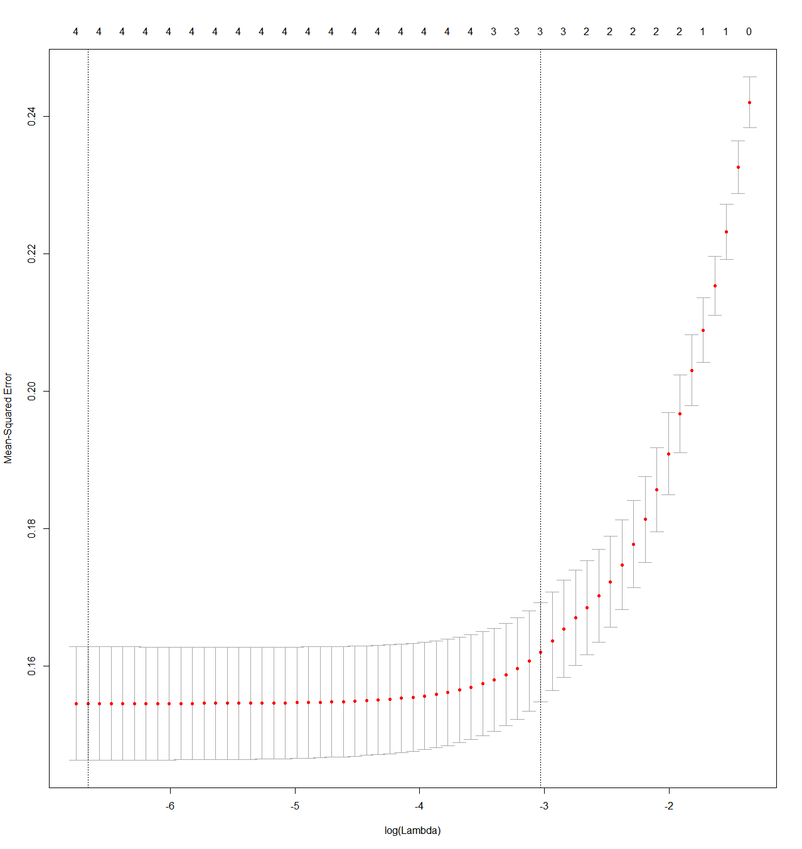
Data Analysis – cv.lasso.model

Slide 14
Data Analysis – setup prediction models
auc.cv.lasso.model <- cv.glmnet(x = as.matrix(traindata.factored[,2:5]), y = as.matrix(traindata.factored[,1]), family="binomial", alpha=1, type.measure="auc")
test.prob <- predict(auc.cv.lasso.model, type="response", newx = as.matrix(testdata.factored[,2:5]), s = 'lambda.min')

Slide 15
Data Analysis – AUC performance
pred.auc <- prediction(test.prob[,1], testdata.factored[,1])
performance.auc <- performance(pred.auc, "tpr", "fpr")
performance.auc(pred.auc, "auc")
performance(pred.auc, "auc")
# plot the ROC curve
plot(performance.auc, colorizer=TRUE)

Slide 16
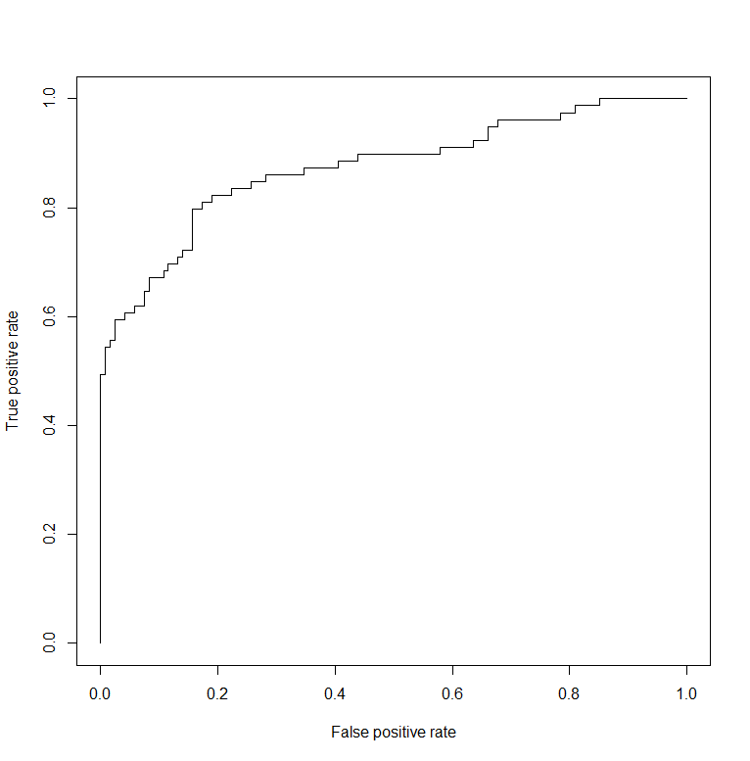
Data Analysis – AUC for auc.cv.lasso.model

Slide 17
Conclusion – LASSO
Useful for feature selection
Cross-Validated model performed fairly well
There is definitely room for improvement
Adjusting lambda value
Including more/less features
Try other values for alpha in glmnet algorithm that will move towards Ridge Regression or Elasticnet algorithms

